Slide 1

Project II: Assignment Specification
Assignment Specification
Produced by: Dr. Frank Walsh
This Photo by Unknown Author is licensed under CC BY-SA-NC

Slide 2
Context
For this assignment you are required to:
Create a working IoT project using a suitable distributed version control system.
Present and communicate your work in a clear, correct manner.
Begin to develop a digital portfolio.
Assessment will be based on technical (e.g., features), communication, organisational and presentation skills.
100% CA
1 overall project

Slide 3

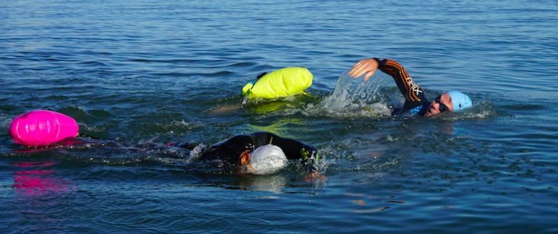
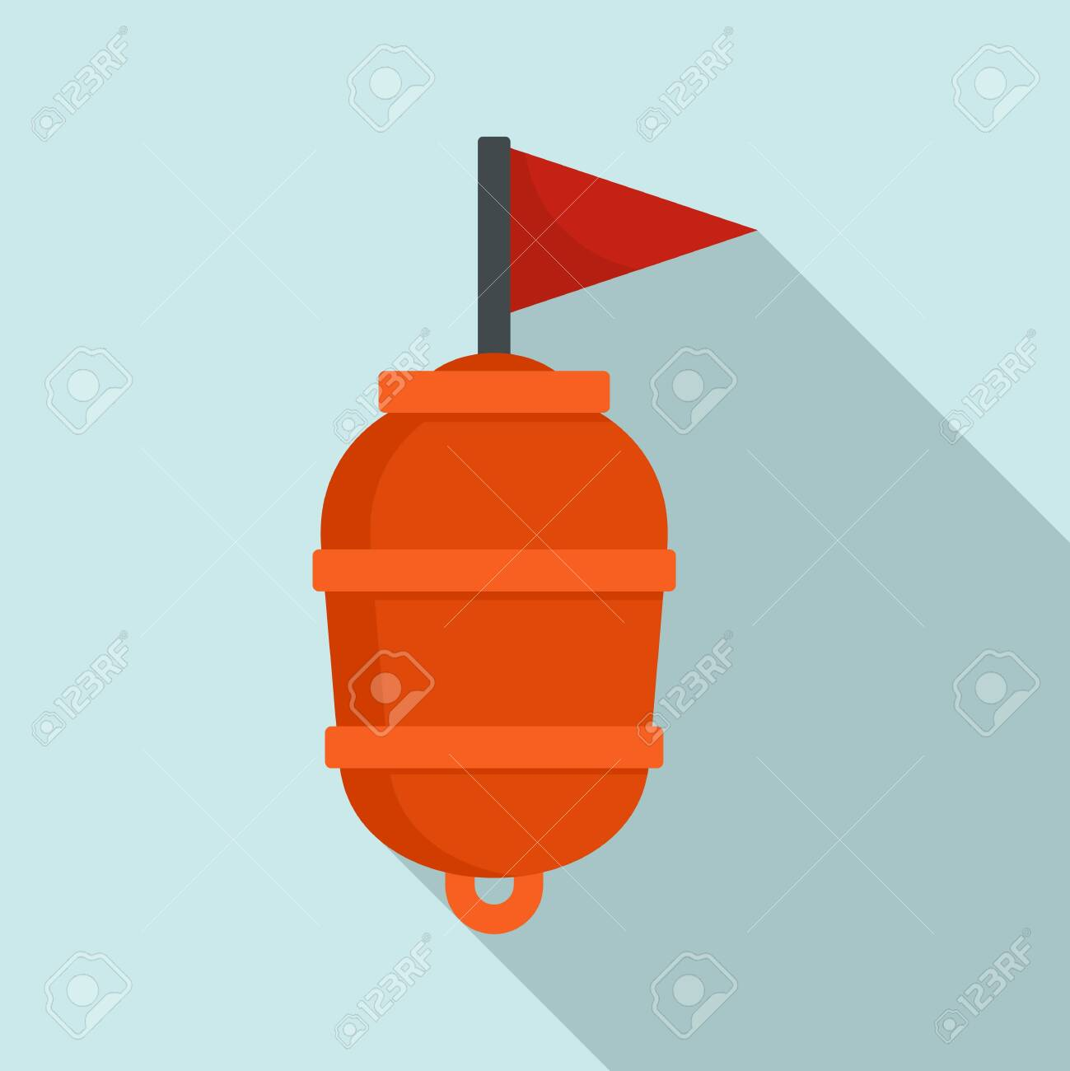
Theme: Marine

Slide 4
Requirements
Propose
Propose a project
High level concept: Title; Description; Tools and Tech.
Model/ implement
Model/implement a solution to your proposal
Use the knowledge, skills and practices from other modules
Version Control
Use a suitable version control system to manage your portfolio of "artifacts".
Communictate
Produce clear documentation and/or training material for your project (e.g. project report, user guide, sushi cards)

Slide 5
Timeline
28 Feb.
Proposal document (for 28th February)
One page document with general concept.
Github repo
13 Mar.
Project Graphics
Pictorial (block level) representation of project
30 Mar.
Interim Report
Updated Readme.md
Feedback on progress
1–9 May
Presentation and interview
Full submission.
Present your work.

Slide 6
Grade Spectrum
 | Combined knowledge (25) | Working Artifact (25) | Digital Portfolio (25) | Communication (25)
Base (40-49) | 2 programme strands present in output. Basic knowledge of each exhibited. | Basic working artifact consisting of a single device. | Basic structured portfolio. No coherent structure | Minimal (1) communication resource used (simple read me).
Good (50-64) | apply concepts from more than two modules/strands.. | Working artifact that connects >= two devices. | Well structured portfolio in source control. | Portfolio includes clear presentation, documentation.
Excellent (65-80) | >2 strands as above and including more advanced knowledge and concepts. | All above, multiple device types to provide functional application. | Continuous update and progression of portfolio. Public site. | In addition, additional communication resources (e.g. instruction video, learning resources)
Outstanding (80-100) | All above, including self-acquired knowledge over and above module content. | All previous to excellent level. | All the above including advanced tools and features (e.g. branches, forks). | All the above, accessible project platform (e.g. web site)

Slide 7
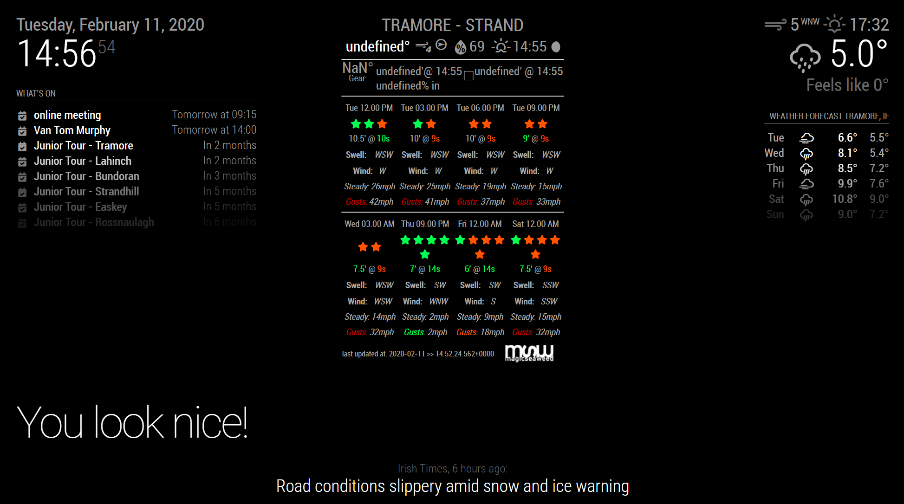
Possible Concept: Conditions Dashboard for TBay

Slide 8
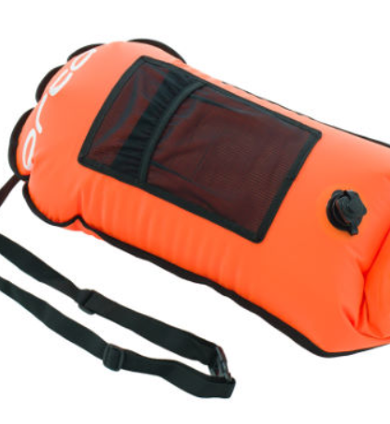
Possible Concept: Safety Sense Buoy
Safety Buoys becoming more popular for open water swimmers
Create a device that:
Attaches/integral to buoy
Transmits location, heading every 2 mins
Emergency button (notifies nok, then emergency services)

